Slide 1
ATTENDANCE MANAGEMENT SYSTEM
AYUSH MALIK
PUSHKAR GOLE

Slide 2
OVERVIEW OF THE PROJECT

Slide 3
AIM
Till now we generally take attendance in colleges using pen and paper.
This project helps to implement this task using computer and internet and simplifies the process.
It helps in ensuring consistent attendance data throughout the college.

Slide 4
How we plan to expand this in future ?
Centralize it from a single college to university level
Include login restrictions
Enable multi-size screens user interfaces
Synchronize it with time tables

Slide 5
BENEFITS OF USING IT
Consistent Data.
It is Speedy.
Search and Query processing is simplified.
Offers accountability
It “will” offer various types of queries for the faculty.
Offers Reliability and Efficiency.
Ease of use and comfort.

Slide 6
What it can do ?
STUDENT
faculty
Login
View Monthly Attendance
View Summative Attendace
Login
Mark Attendance
View Attendance
Edit Attendance

Slide 7
TECHINCAL IMPLEMENTATION

Slide 8
Software Requirement Specifications

Slide 9
Technologies and languages used
HTML
JAVASCRIPT
JAVA
JAVA SERVER PAGES
MySQL SERVER
APACHE TOMCAT
WEB BROWSER (JAVA SCRIPT ENABLED)

Slide 10
DATA BASE DESIGN
Entity Relationship Model
Relational Model
SQL Implementation

Slide 11
NOW LETS HAVE A LOOK AT THE FINAL BUILD RUNNING

Slide 12
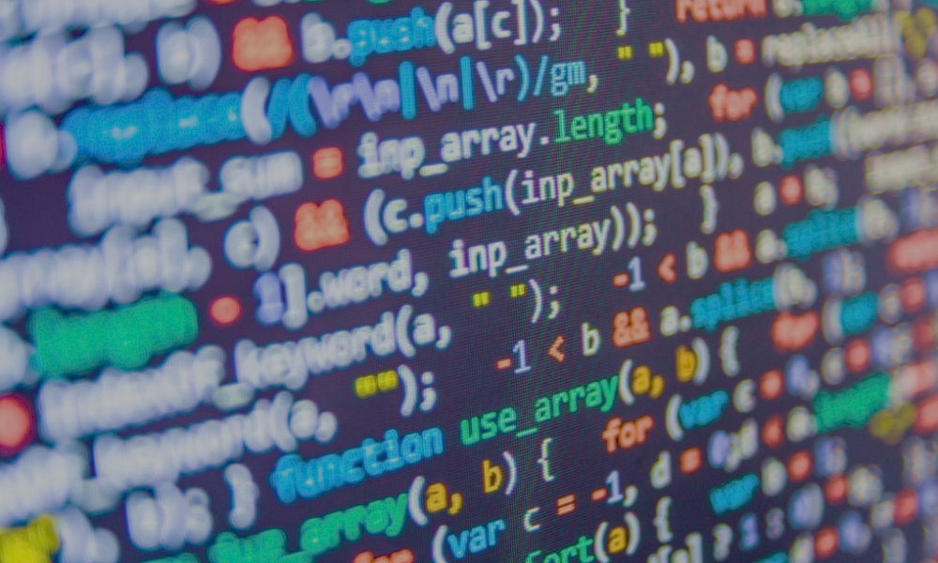
THE CODE
The code consists of a number of web pages and a few other files. Each of those files has been specified below separately

Slide 13
login.jsp
faculty_home.jsp
take_attendance.jsp
edit_attendance.jsp
student_home.jsp
monthly_attendance_temp.jsp
summative_attendance.jsp
view_attendance.jsp
newjsp.jsp
report.jsp
index.jsp

Slide 14
We have started working on enhancements

Slide 15
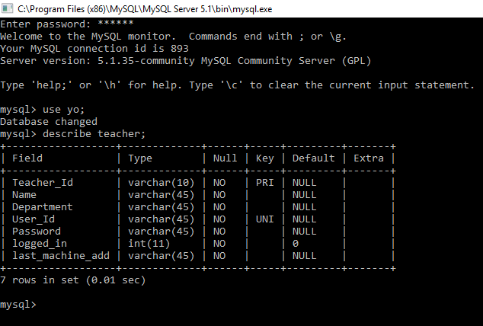

Slide 16
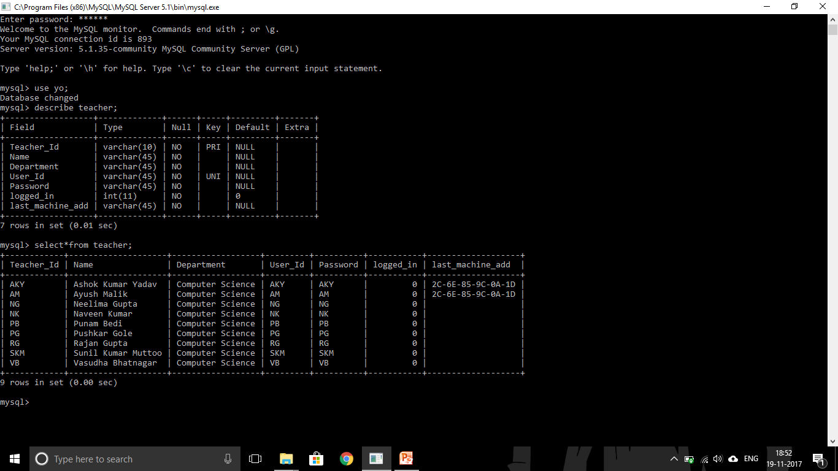

Slide 17
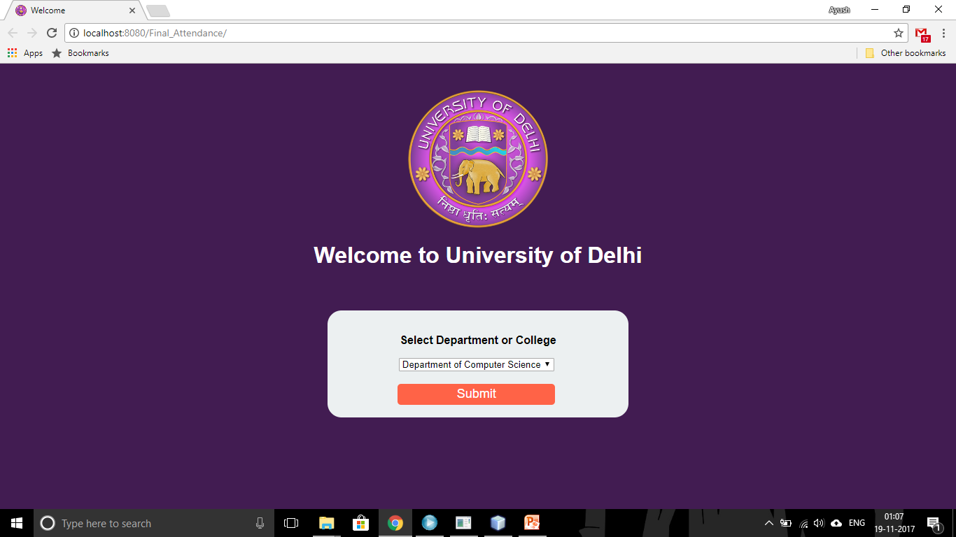

Slide 18
Thank YOU

